Slide 1

Faculty of Science & Technology
Jagran School of Engineering
Minor Project Presentation
Skin Diseases Prediction Using Deep Learning
Under the Supervision of:
Asst. Prof. Priyank Dubey
JLU-FAST
Presented by:
Khushi Parmar
2023BTHCSE009
Shreya Mahajan
2023BTHCSE017

Slide 2
Outline
^{Introduction}
Importance and Need of Your Project
^{Features of your project}
^{Uniqueness of Project}
^{Tools and Technologies}
^{User requirements}
^{Activity Diagram}
^{Conclusion}
^{References}

Slide 3
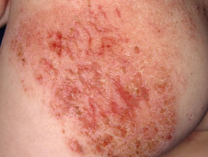
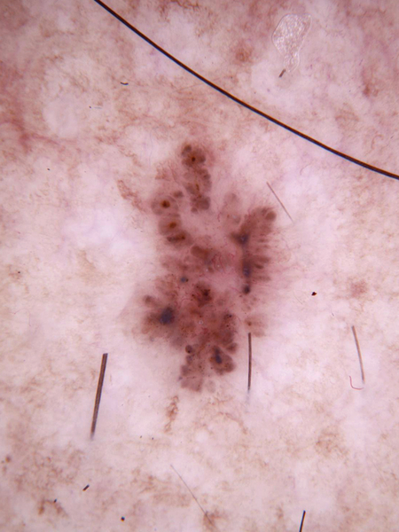
Introduction
Skin diseases, often ignored or misdiagnosed due to limited dermatologist access.
This poses significant health risks.
Early and accurate detection is crucial.
One of the major challenges lies in the fact that dermatological care is not equally accessible to all.
Many people are unaware of the early symptoms of skin diseases.
This delay in diagnosis highlights the urgent need for timely detection and proper treatment.

Slide 4
Importance & Need of Our Project
Ignored Skin Diseases: Common conditions like eczema and psoriasis are often dismissed, leading to chronic complications or severe infections.
Lack of Dermatologists: Rural areas face a critical shortage of specialists, delaying care and worsening health inequities.
Delayed Detection: Late diagnosis of melanoma increases mortality due to limited access and awareness.
Manual Diagnosis Limitations: Slow, subjective visual inspections by clinicians are prone to errors, delaying effective treatment.
AI Diagnostic Potential: AI delivers fast, accurate skin disease detection, scalable via mobile apps.

Slide 5

Features of our Project
Detects skin diseases using Deep Learning (CNNs).
A Convolutional Neural Network (CNN) is a type of deep learning model specially designed for image recognition and classification.
In feature extraction, Strided Convolution, Padding Methods, Multiple Filter Banks.
MobileNetV2: Lightweight CNN architecture designed for fast, efficient image classification using depth-wise separable convolutions and inverted residual blocks.
EfficientNetB0: Highly optimized CNN model that scales depth, width, and resolution efficiently to achieve strong accuracy with low computational cost.
Accepts skin images as input.
Activation Functions: Learn complex patterns by using ReLU (Rectified Linear Unit) using formula: f(x)=max(0,x) and Softmax by formula

Slide 6
Reduce feature map size, keep important information by pooling methods:
  Global Average Pooling (GAP): Used before final classification, averages the whole feature map.
  Batch Normalization: Normalizes layer inputs across the mini-batch to stabilize and speed up neural network training.
Regularization Methods
  Dropout: Randomly “drops” neurons during training.
  L2 Regularization: Penalizes large weights. [J_{new}​(θ)=J(θ)+2λ​=^{i}∑_{n}​θ_{i}²]
Data Augmentation: Increases data variability to reduce overfitting.
Optimization methods: Adam Optimizer (Adaptive Moment Estimation)
Outcome: Improved skin disease classification accuracy through efficient feature extraction and strong regularization.

Slide 7




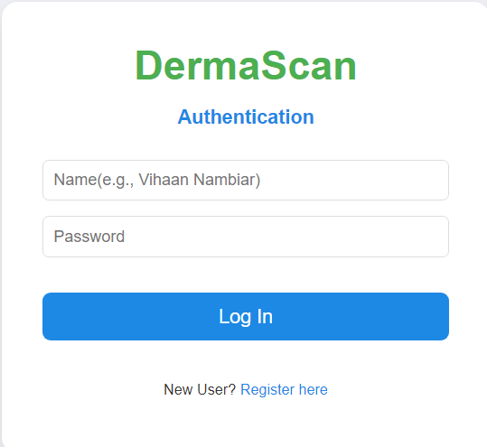
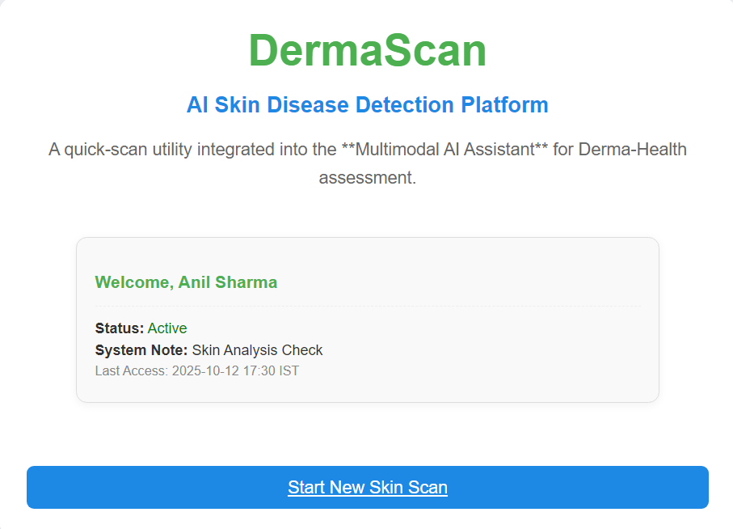
Tools and Technologies
Programming Language: Python (mainly), HTML, CSS, JavaScript
Python3.10
HTML
CSS
JavaScript
UI of the Website Developed

Slide 8
User requirements
Smartphone or PC with camera.
Stable internet connection.
Simple user interface (easy upload & result view).

Slide 9
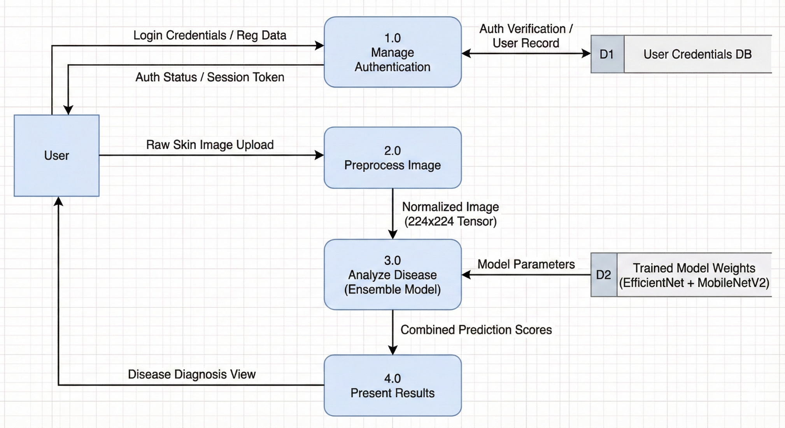
Activity Diagram
Data Set Link –
https://www.kaggle.com/datasets/ismailpromus/skin-diseases-image-dataset
The data consists of images of 10 types of skin diseases .The categories include acne, melanoma, Eczema, Melanoma, Psoriasis, Seborrheic, Basal Cell, etc.

Slide 10
Conclusion
The Skin Disease Prediction Model is an advanced healthcare solution designed to provide fast, accurate, and reliable detection of various skin conditions.
Using the power of Deep Learning, particularly Convolutional Neural Networks (CNNs).
Diseases like melanoma, if not detected in the initial stages, can quickly become life-threatening.
The model enhances the chances of early detection, thereby increasing the likelihood of timely treatment and improving patient survival rates.
In essence, the Skin Disease Prediction Model is not just a technological advancement.

Slide 11
Thank You
"Our goal is simple: make healthcare faster, smarter, and accessible for everyone."

